Slide 1
Accelerating data Engineering Pipelines
Part 3: Data Visualization

Slide 2

Agenda
Part 1: Data Formats
Part 2: ETL with NVTabular
Part 3: Data Visualization

Slide 3
Agenda – Part 3
Data Quality
Interactive Dashboards
Plotly

Slide 4
Data Quality

Slide 5

Becoming a data Detective
What is wrong with the following data?
Notes:
Data bugs can be quite tricky because even though a pipeline is running fine, it might not be immediately obvious that the values of the data are off.
There is no secret technique to being able to identify data quality at a glance. Most of it comes down to practice and learning to develop a critical eye. So, for the next few slides, we are going to play a quick game of “what’s wrong?”

Slide 6
What is Wrong with This data?
North America Temperature
Temperature | Mexico City, Mexico | Washington, DC, USA | Ottawa, Canada
Average | 14 | 36 | -7
Median | 12 | 37 | -8
Mode | 12 | 36 | -8
Min | 5 | 25 | -14
Max | 22 | 43 | -5
Notes:
Before we get into debugging visualization, let’s look at some numbers. These are hypothetical temperatures for the month of January. There’s something wrong with this table. What is it?
USA’s numbers are in Fahrenheit whereas the other two are in Celsius. Now it is an unfair comparison, isn’t it? This one is tricky to build a unit test for because it is possible to have an unusually hot or cold day, and numbers certainly very by region.

Slide 7
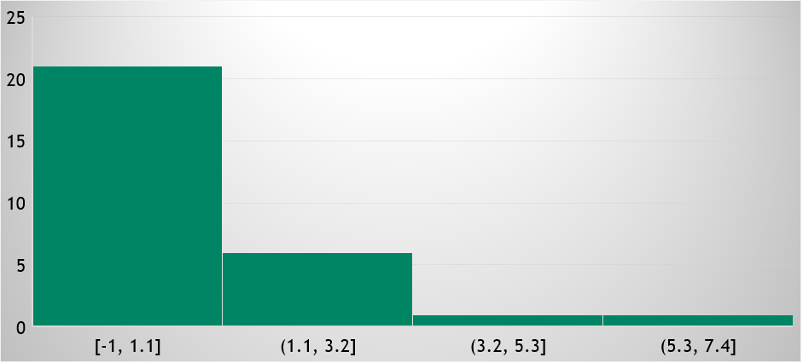
What is Wrong with This data?
Candy Bars Eaten in a Day
Frequency
Number of Candy Bars Eaten
Notes:
Let’s move on to some more visual data. Here, we have a histogram: I have studied how many candy bars I eat each day for the last month. On the x axis, we have a range of how many candy bars I could have eaten, and on the y axis, we have how many days I ate a number of candy bars within that range.
So what’s the story here? What is wrong?
If we look at the labels of the candy bar range, we can see that the first bucket goes from -1 to 1.1.
Eating -1 Candy bars? What does that even mean?
Turns out, I was recording my numbers at the end of the day, and since my data format required that I use an integer, I used “-1” to mean that I forgot the number of candy bars that I ate that day. Next time, I should remove these before building a chart.

Slide 8
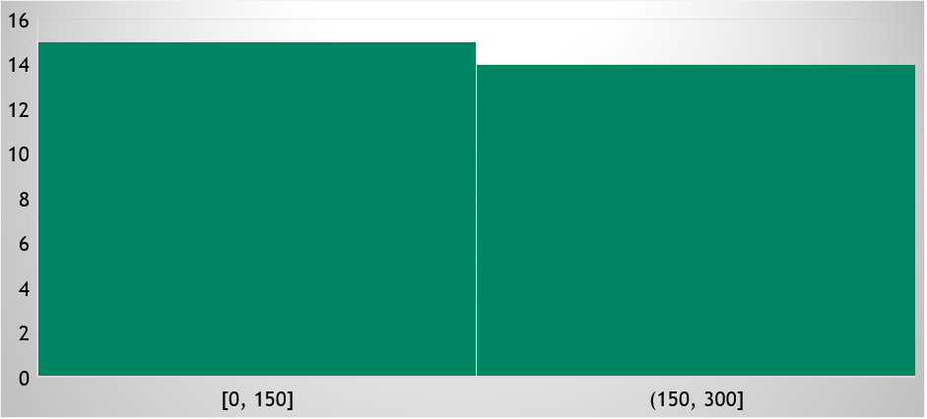
What is Wrong with This data?
Candy Bars Eaten in a Day
Frequency
Number of Candy Bars Eaten
Notes:
So, let’s say I go and fix those -1s, or at least I thought I did. Turns out I messed up and made another mistake. Any idea what it was?
Turns out, instead of treating my -1s as NaNs, I converted them from signed integers to unsigned integers, meaning, I now have many days where I ate 255 candy bars! That’s way too much!

Slide 9
What is Wrong with This data?
Hours Playing Video Games
Hours Played
Day
Notes:
This is supposed to be a plot of how many hours in a day are spent playing video games over the course of 3 days.
What is going on with these spikes?

Slide 10
What is Wrong with This data?
Hours Playing Video Games
Hours Played
Day
Notes:
It turns out, I was plotting multiple series as though the were one series. By splitting it out, we can now clearly see that Jacqui plays way more games than Mike or Marina.

Slide 11
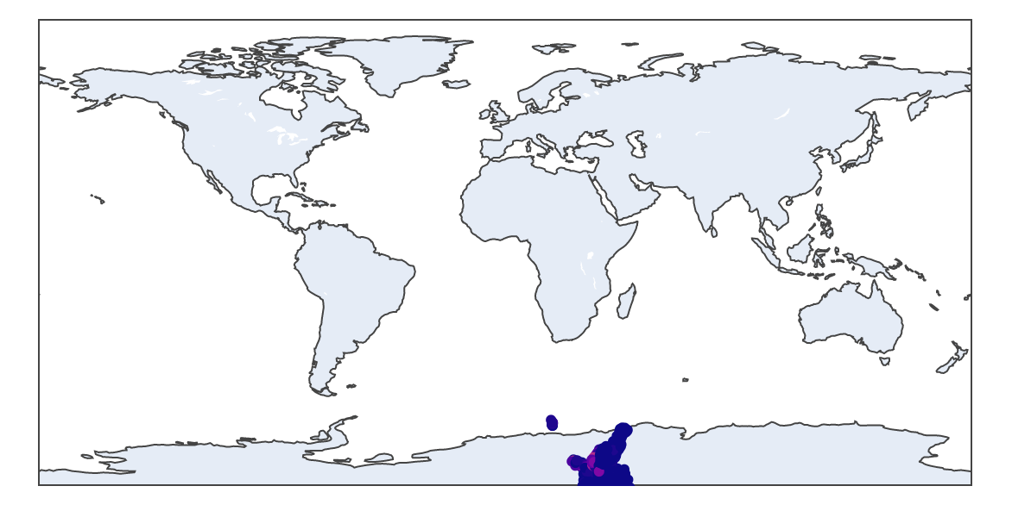
What is Wrong with This data?
United States Precipitation
Notes:
This one is a teaser for the upcoming lab. Let’s say we’re trying to plot USA precipitation data and we get this. The data is nowhere near the US. What is going on?
No problem. The latitude and longitude are just flipped.

Slide 12
Interactive Dashboards
Notes:
Now that we know how to debug data and images, let’s move on to making interactive dashboards.

Slide 13

The Internet
The world’s largest system of digital data?
Notes:
In this data engineering series, we have been referring to different types of data pipelines as a subset of system’s engineering. The internet itself is the result of the early pioneers of systems engineering. After the world wars, the government agencies that funded the initial research into computer networks put high importance on efficient, reliable, and secure ways to transfer information.
Covering this in detail could easily fill a college textbook, but we will get started with the basics by building our own data dashboard.

Slide 14




A Dashboard data Pipeline
A Simple Server
1: User asks for information
Client
Server
2: Server returns webpage with all data
3: User’s computer filters data for interactivity
Notes:
Here’s one simple way we could set up our dashboard data pipeline. Our user is going to send a request to see our dashboard with their computer (the client). That request gets sent over the internet and hits our server. The server returns the website along with the data, and the user’s computer can take care of the heavy lifting.
This isn’t a terrible model and might even be the best solution if our data is small. However, if it is a large amount of data, we can’t expect everyone to have a supercomputer, especially is our dashboard is to be accessible by mobile phones.

Slide 15

Dashboards for Big data
A More Complex Server
1: User asks for information
Client
Server
CPU
Server
GPU
2: Server returns webpage
4: CPU requests computation from GPU
3: User requests filtered data
6: server returns filtered data
5: GPU returns result
Notes:
Here is a slightly more complicated way to do things, but this will allow us to serve more data to our users.
Just like before, our users request the website, and we will give them a default view of the dashboard to start. Next, when the user interacts with the website in a way that would need computation on the data, it sends another request to the server.
The server then asks the GPU to perform the computation. Most web frameworks cannot read directly from the GPU, so the result will need to be sent back to the host device in order for it to be delivered to the client.
Like usual when working with GPU frameworks, we need to consider if GPU speedup is worth the round trip from host RAM to the GPU. In this case, there’s also added lag as information travels across the Internet, so this added complexity makes more sense with bigger data.

Slide 16

Making a Good Dashboard
Date: 1969-07-20
Show Zeros
Notes:
We are not going to go too much into user interface theory. As some of you have probably already experienced, some people have strong opinions on what makes a good presentation.
In fact, it is difficult to please everyone, but one way we can try to do so is by adding interactivity in our dashboards. Above is a mock of what we will be building in the lab. We’ll be making a dashboard that tracks United States precipitation. We are excited for you to get into the hands-on portion so you can see it in action, but we will try our best to describe it in noninteractive slide form.
We’ll have two main ways for users to interact with this map in the upper left-hand corner. One is a date selector to choose the day to view the precipitation for. Most days do not have any precipitation at all. Should we show those datapoints or not? We’ll let the users decide and include it as a switch.
Letting our curiosity guide us is a great way to make an interactive dashboard. Let’s say we have some sales data. We can ask ourselves, can we filter this by region? Or can we group this by date, month, or quarter? No doubt as your dashboarding skills improve, your users will suggest their own ideas as well.

Slide 17
Plotly Dash
Notes:
The technology we’ll be using to make these dashboards is called Plotly Dash. Let’s quickly go over how it works.

Slide 18
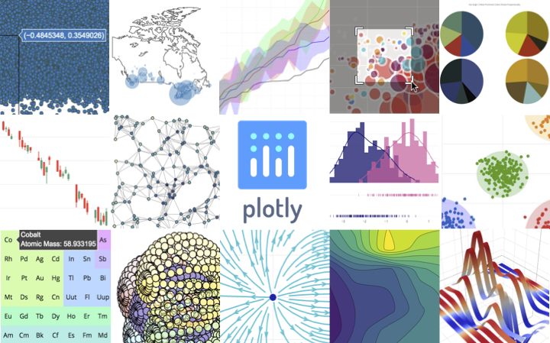
Plotly DASH
The front end for ML and data science models
plotly.py is an interactive, open-source, and browser-based graphing library for Python
Supports line plots, scatter plots, area charts, bar charts, error bars, box plots, histograms, heatmaps, subplots, multiple-axes, polar charts, and bubble charts.
https://github.com/plotly/plotly.py
Notes:
Other viz library options:
RAPIDS cuxfilter - cuxfilter ( ku-cross-filter ) is a RAPIDS framework to connect web visualizations to GPU accelerated crossfiltering.
Bokeh (https://docs.bokeh.org/en/latest/#) - Bokeh is a Python library for creating interactive visualizations for modern web browsers.
Datashader (https://datashader.org/) - Datashader is a graphics pipeline system for creating meaningful representations of large datasets quickly and flexibly.
panel (https://panel.holoviz.org/) - Panel is an open-source Python library that lets you create custom interactive web apps and dashboards by connecting user-defined widgets to plots, images, tables, or text.

Slide 19
Making a Good Dashboard
Div
Date: 1969-07-20
Show Zeros
Div
DatePickerSingle
id=“date-picker”
BooleanSwitch
id=“show-zeros”
Graph
id=“precipitation-map”
Notes:
What is nice about Plotly Dash is that we can build our entire web application using just python! That said, a little bit of knowledge of HTML will still help us.
We can imagine each of the components of our dashboard has an invisible box around it called a “Div”. This is how HTML organizes the components. Each div can have an optional attribute called an “id” which must be unique so we can uniquely identify it.
On the left, we have our mock, and on the right, we have how the divs would be organized to build that mock.

Slide 20
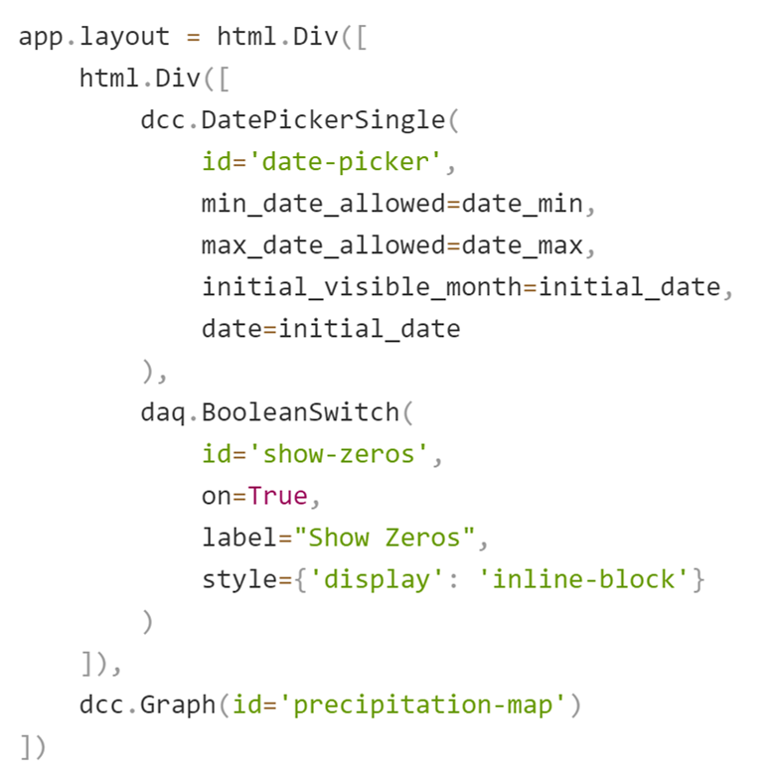
Making a Good Dashboard
Div
Div
DatePickerSingle
id=“date-picker”
BooleanSwitch
id=“show-zeros”
Graph
id=“precipitation-map”
Notes:
Plotly builds this HTML by using its HTML component functions. Its html.Div function accepts a list which can be filled with more Divs or other functions.
Here, we can see that we’re using the “DatePickerSingle” component to build our date selection interactivity and “show-zeros” to add our switch.

Slide 21
Making a Good Dashboard
@app.callback(
Output(‘precipitation-map`, `figure`),
[Input(‘date-picker’, ‘date’), # 1st input
Input(‘show-zeros’, ‘on’)]) # 2nd input
def make_graph(first_input, second_input):
…
regular python function stuff
…
return fig # Must match Output data type
Notes:
So now that we have the layout of our webpage, how do we add the interactivity? Plotly has an interesting function wrapper.
We can wrap any python function with the @app.callback wrapper. The first argument is the Output we want to change. We can only change one Output per function, and we pass in the HTML id of the component we’re changing and what property of that component we’re changing. In this example, we’re choosing to change the “figure” property of our graph component, so we must return a figure, but we can alter any property of the graph such as the HTML style. This provides a lot of power and we can do things like let the user define the size of the graph.
Next, we can use any other component properties as inputs into our function. Again, we’ll use the HTML id of the component to identify it. These inputs will be used as inputs to our python function, in the same order as they are in the callback Input array.

Slide 22
Let’s go!
Notes:
If this seems like too much too quickly, don’t sweat it. Due to the interactive nature of the dashboard, it will make more sense when we start interacting with it.
Let’s get to it!

Slide 23
Next Steps
Notes:
Before we end the class, we’d like to go over a few more tools that could be useful going forward.

Slide 24




Other Tools
Notes:
One of the trickiest aspects of being a data engineer is figuring out if a new technology is worth the time and money to implement.
blazingSQL allows users to make SQL like queries on their data enhanced with the speed of their GPUs.
Bokeh is a python plotting library that renders JavaScript powered plots for the web.
Datashader is another plotting library made for rendering millions of data points.
Panel is a tool to turn python function into an interactive dashboard.
We have gathered these technologies and the technologies used in today’s class into a “Data Engineering Toolbox” Docker Container.

Slide 25
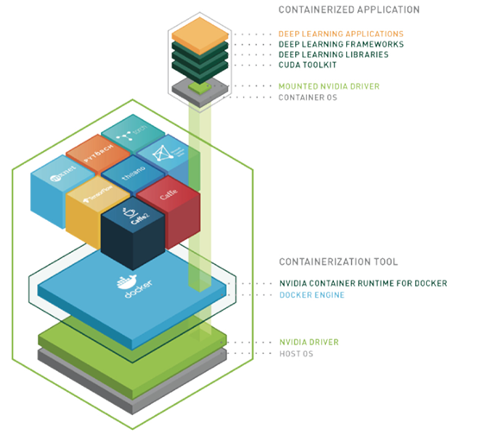
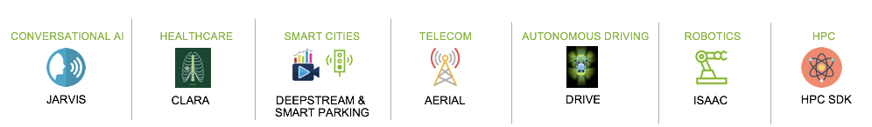
ENABLING PORTABILITY WITH NGC CONTAINERS
NGC Deep Learning Containers
Extensive
Diverse range of workloads and industry specific use cases
Optimized
DL containers updated monthly
Packed with latest features and superior performance
Secure & Reliable
Scanned for vulnerabilities and crypto
Tested on workstations, servers, & cloud instances
Scalable
Supports multi-GPU & multi-node systems
Designed for Enterprise & HPC
Supports Docker, Singularity & other runtimes
Run Anywhere
Bare metal, VMs, Kubernetes
x86, ARM, POWER
Multi-cloud, on-prem, hybrid, edge
Learn more about NGC Containers
Notes:
Docker is a useful tool for packaging software stacks for use on other machines. These packages are called containers. They are very similar to virtual machines, but the difference is that they use the host machine’s operating system and hardware instead of using simulated hardware.
NGC is an online platform that hosts Containers and other AI resources that are free to download.

Slide 26
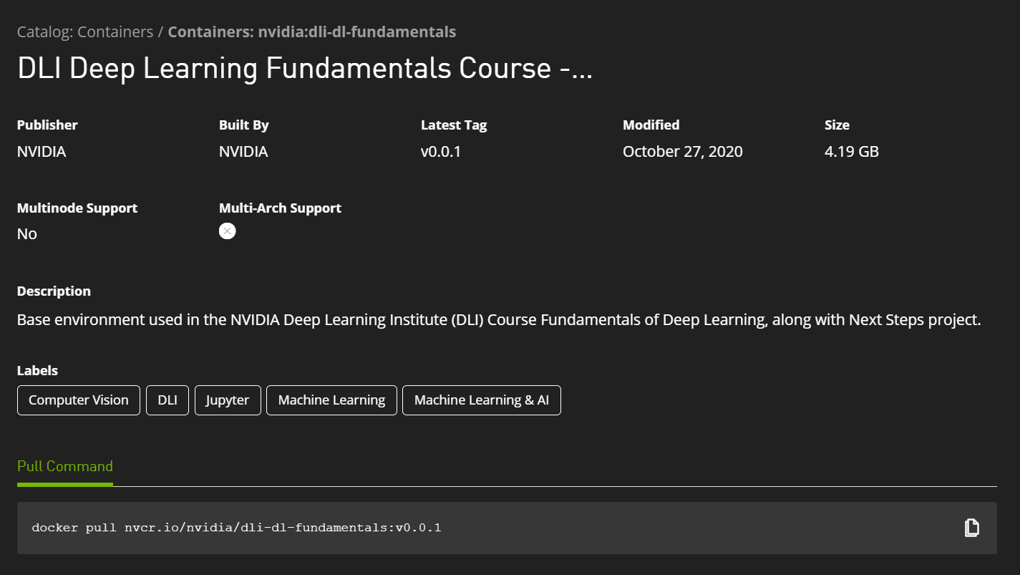
NEXT STEPS FOR THIS CLASS
Step 1
Setup Docker
https://www.docker.com/
Step 2
Visit NGC Catalog
https://ngc.nvidia.com/catalog/containers/nvidia:dli-data-engineering
Step 3
Pull and Run Container
Visit localhost:8888 to check out a JupyterLab environment with a Next Steps Project
Log in to nvcr.io
Notes:
If you know how to use Docker and have a machine that supports CUDA 11.0, you can easily recreate the environment for this class. We are not going to go over Docker Setup as that is going to be unique to each person’s machine. Once docker is set up, it is easy to use. “docker run” will run the container, the contents of which can be accessed both through the command line and through the browser if it has ports exposed.
For DLI, we have prepared follow up material for the class in a Docker Container. It creates a JupyterLab environment just like the one we have used in the class so you can get it set up locally on your own machine. More detailed instructions on how to get this container up and running are provided in the links above, so please check it out.

Slide 27

Closing Thoughts
Humans as a System?
Notes:
One more philosophical thought as we close things out. Throughout this course, we have mostly focused on digital systems, but what about the humans that work on those systems? Where do they fit in?
Remember at the beginning of the course when we talked about how we can observe systems from a very narrow or very wide scope. It turns out, we can do the same thing with humans as well.
On the narrow end of the spectrum, we are a system of biology: our hearts and minds are connected through nervous and cardiovascular systems. Just like any machine, if we hold off our routine maintenance, and do not get a full night of sleep each night, we’re more likely to run into unplanned maintenance by falling ill.
On the wide end of the spectrum, we are not just individuals, but we are connected by our families, friends, and communities. Our actions impact each other.
The early system engineering pioneers realized this and spent a good amount of time developing the philosophy of how human systems become intertwined with mechanical systems. As these mechanical systems are designed and operated by humans, their quality is affected by the humans they interact with.
It is easy to be hard on ourselves when we make a mistake, but it turns out that the same level of objectivity used for assessing machine quality can also be useful for assessing human teams:
Perfection is an impossibility: have a backup plan.
N+1 redundancy: rely on teammates when stuck just as they will rely on you.
Take care of yourself and your teammates: pushing the limits might seem like a good idea in the short term, but it is a mathematically bad idea in the long term.
While AI has come a long way, we humans have an ability to learn from each other that machines have not fully been able to replicate. Because of this, our machines allies will likely rely on us for a long time to come.
https://asq.org/quality-resources/total-quality-management/deming-points

